Slide 1
Personalized Public Displays
Implementation
Juan Camilo Garcia Henri Koski Yifei Zuo Haejong Dong

Slide 2
Table of contents
Purpose of the Project
Implementation process
System overview
Software Architecture
Personalisation algorithm
User Interface
Demo
Security & Privacy
Risks
Evaluation
Contributions

Slide 3
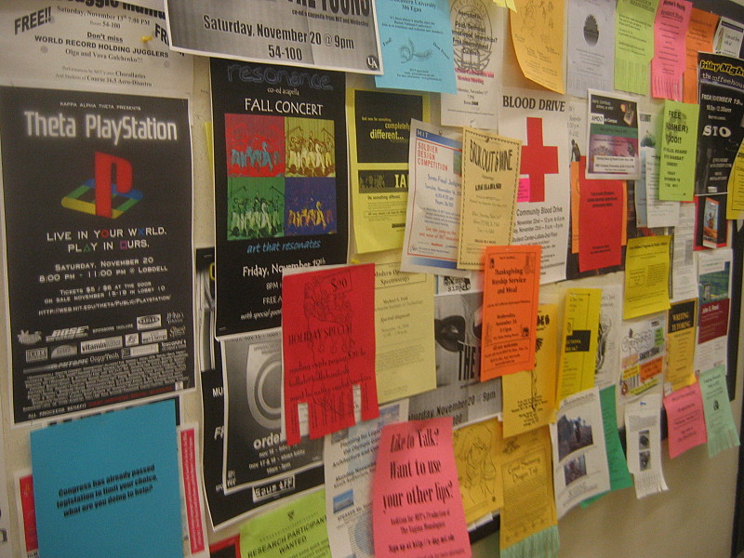
Purpose of the Project
Provide a better alternative to bulletin boards
Make bulletin boards smart.
Personalise Public displays.
Notes:
Hard to find useful information
Hard to find changes
DIfficult to update changes

Slide 4
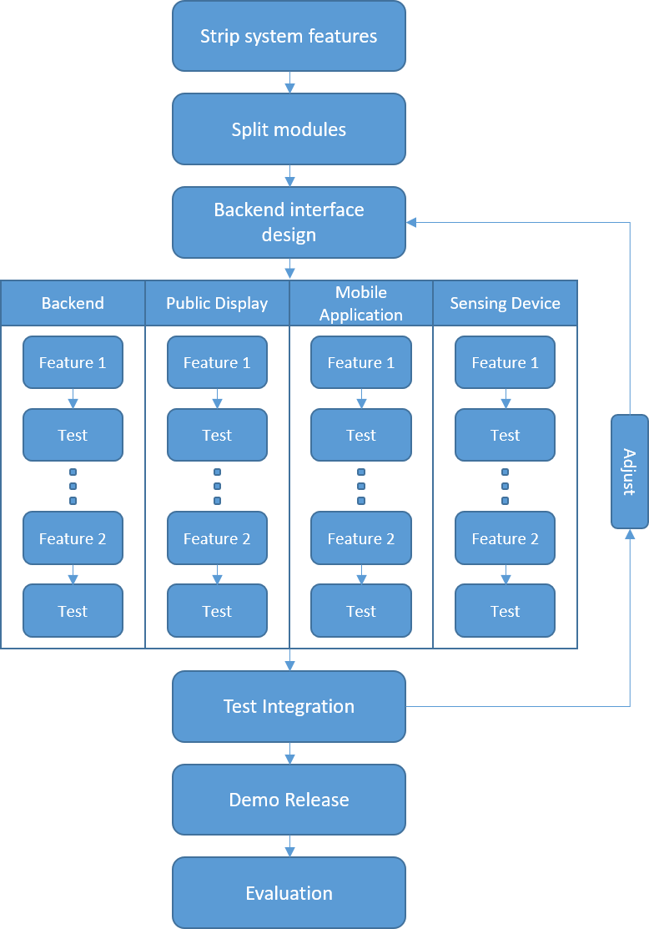
Implementation process
Features kept:
Device recognition through WiFi
Display personalisation
Dashboard to upload events
Support for several displays
Features dropped:
Custom map of the University
Special UI for each type of category on the phone
Navigation directions on the public display
Arrows on the public display showing the direction
Support for dynamic Mac Addresses
Notes:
Feedback to local government
Queue estimations
Micro tasks (as workstations)
More into our topic:
Personalise content: Google search, Youtube videos, songs, images, etc
Focused on security, how to communicate and find public displays

Slide 5
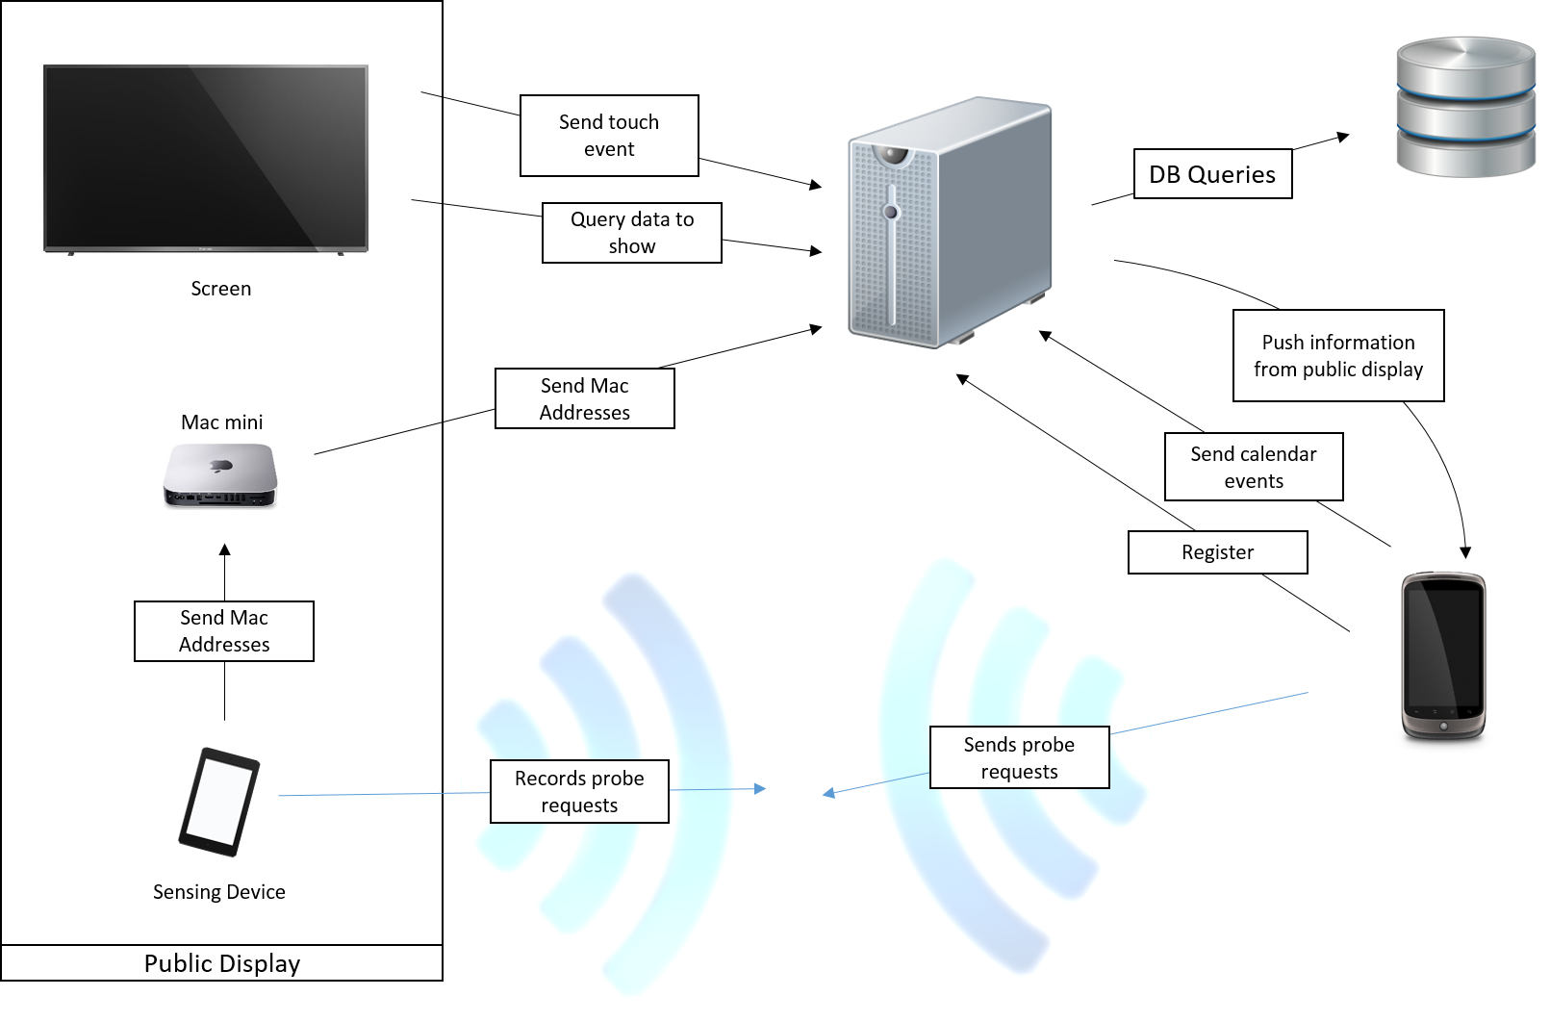
Software Architecture
Notes:
News non-actionable
Reminder actionable
Actionable has deadline and incites people to act
Discount, exam registration…
Non-actionable has no deadline and no action
Normal news or announcements

Slide 6
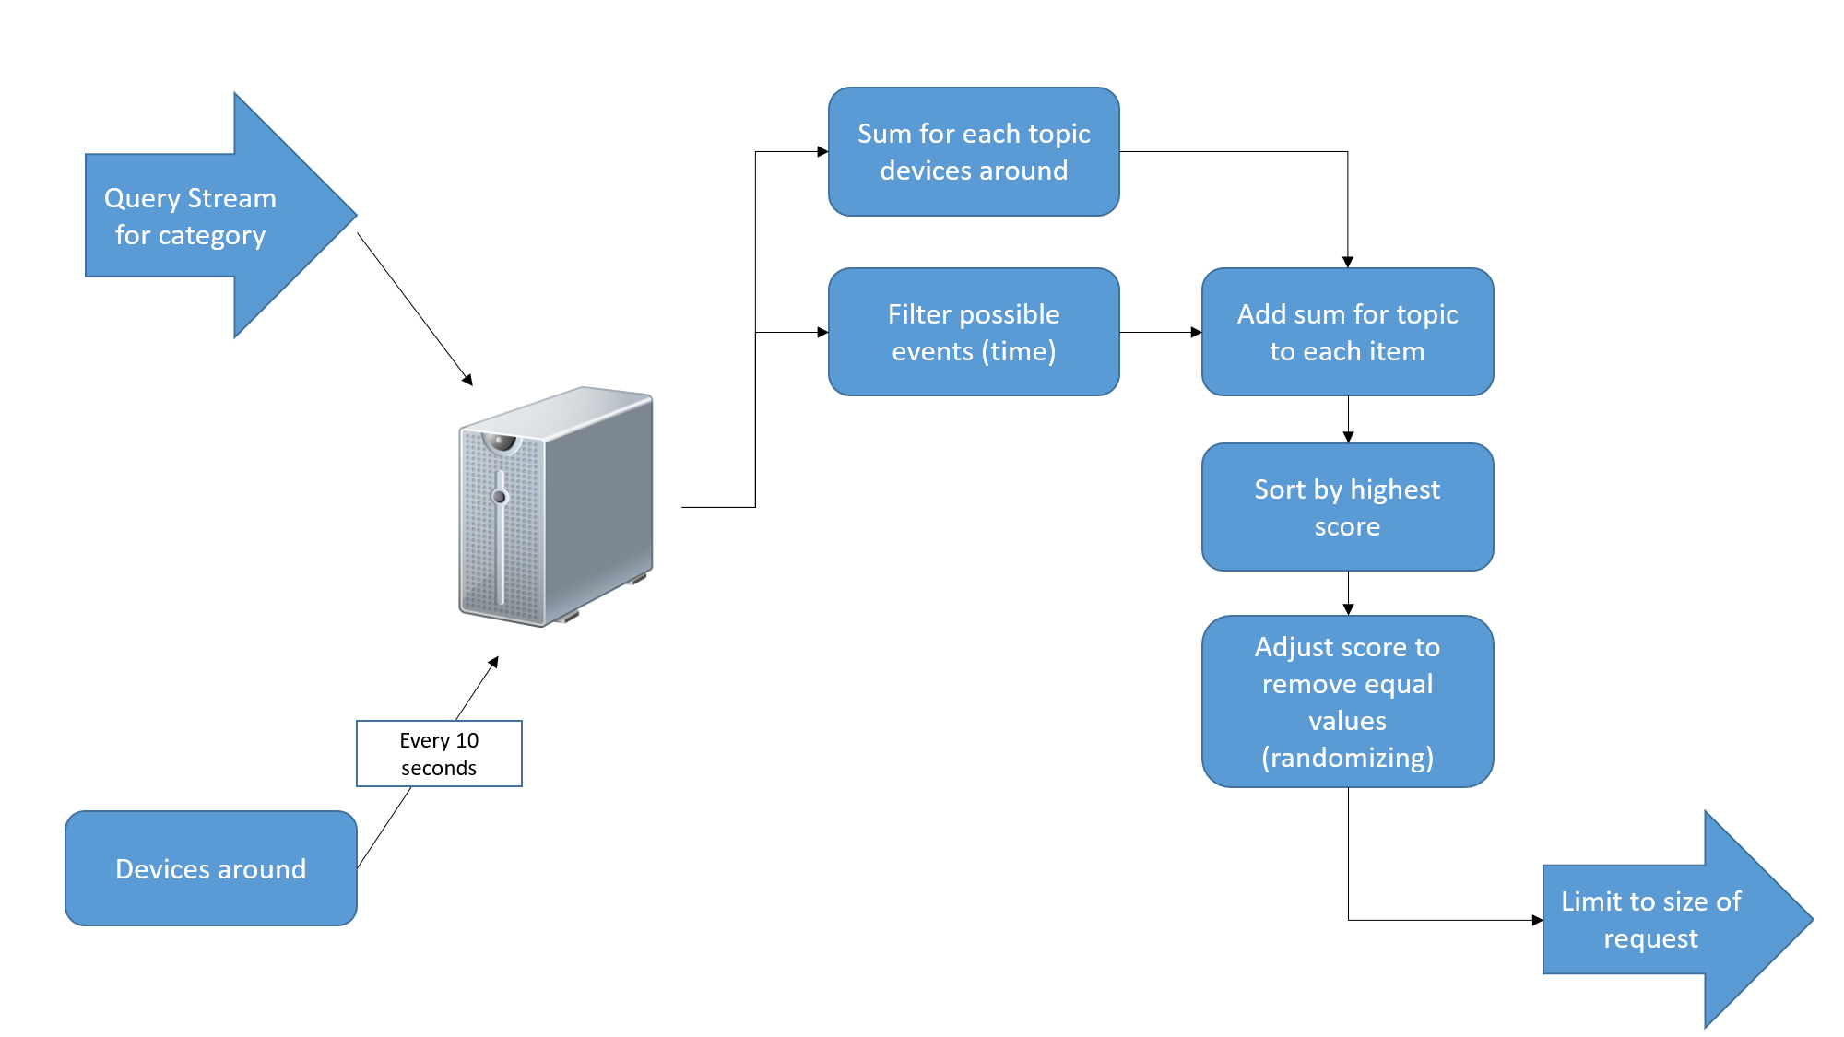
Personalisation Algorithm

Slide 7
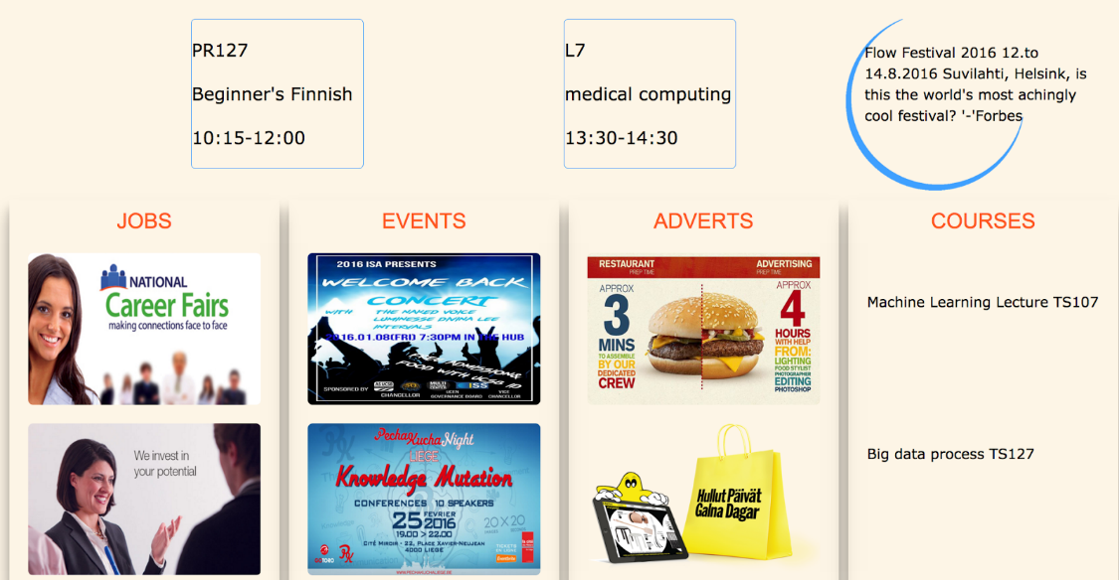
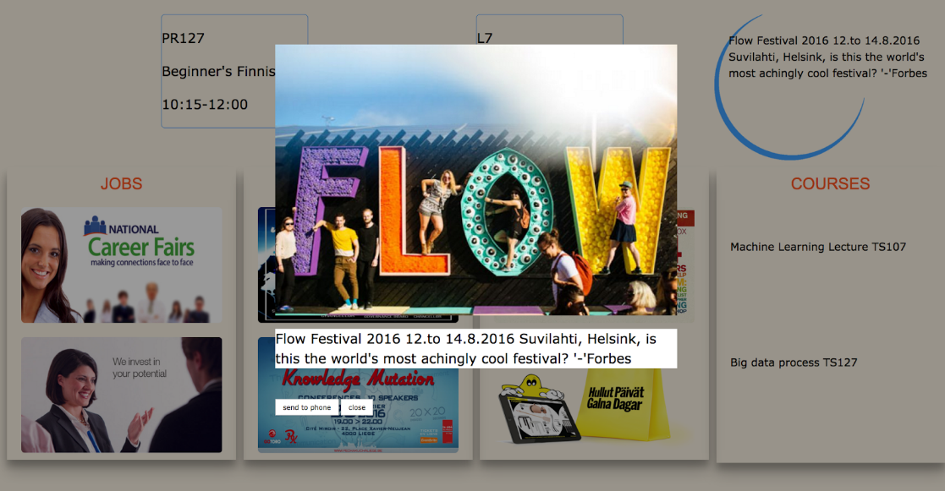
User Interface - Public Display
Public Display Homepage
Item Selected

Slide 8
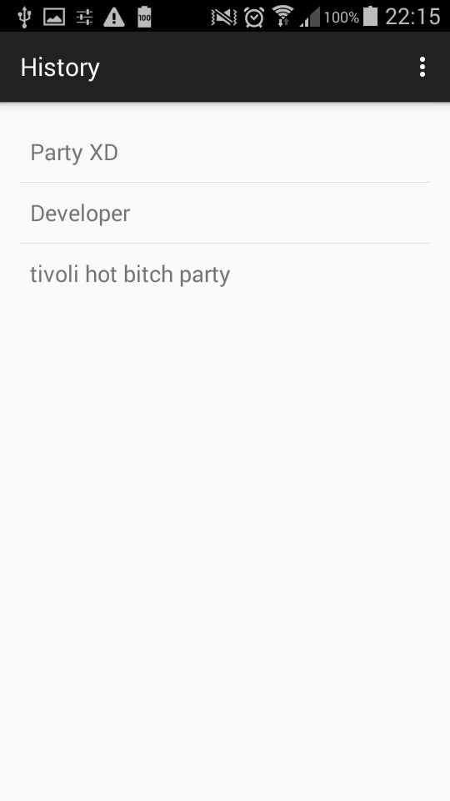
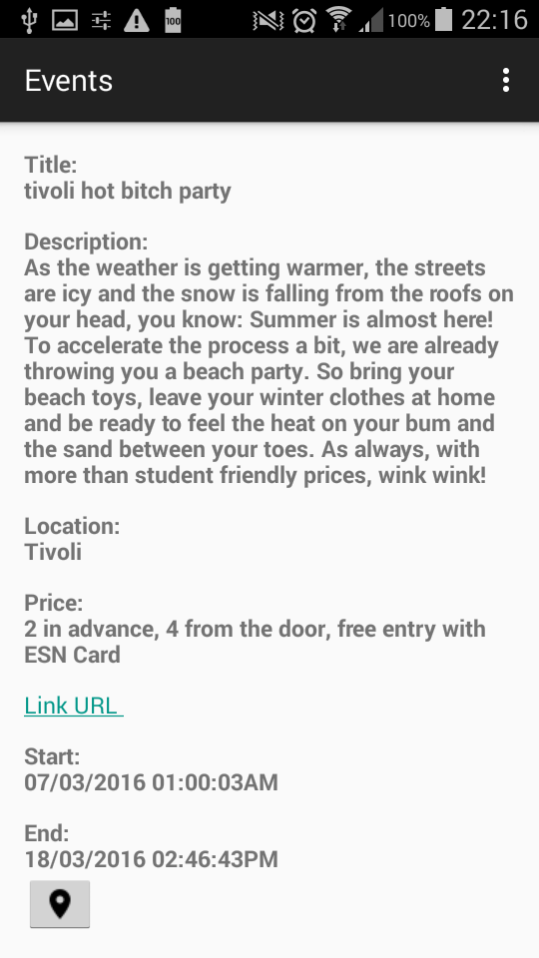
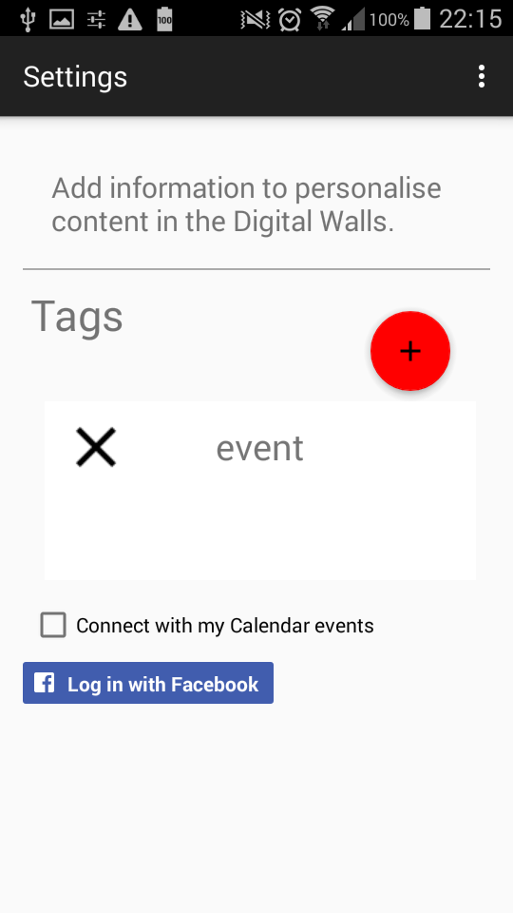
User Interface - Mobile Client
History
Event
Settings

Slide 9
Demo

Slide 10
Security & Privacy
All connections are encrypted
No tokens can be captured
No private personal events can be captured
Users’ ids are auto increment
Will be changed to UUID v5 (RFC4122)

Slide 11
Risks
Fault sensing risk
Wrong device detection through signal strength.
Prevention: Personal data will only be sent to the owner of it.
Problem: Bad user experience.
Solution:
Find a better way to assess closeness of devices
Change interaction to send information

Slide 12
Evaluation
Accuracy of sensing device
How many times users go back to previous results
Viewing on public display vs. mobile client
Time a device is near a display (session length)
Percentage of possible users interacting
Change of usage due to personalisation

Slide 13
Contributions
Name | Contribution | Hours
Haejong Dong | Mobile Client, Report Writing | 68
Juan Camilo García | Sensing Device, Report Writing | 54
Henri Koski | Backend, Admin Panel, Report Writing | 63
Yifei Zuo | Public Display, Report Writing | 67
Simo Hosio | Feedback | N/A

Slide 14
Thank you for your time

